Slide 1
Walmart Sales Presentation
Group 8

Slide 2
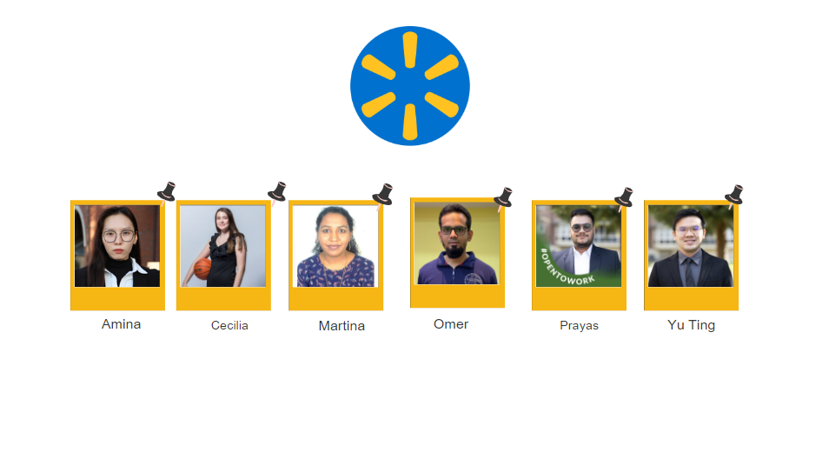
Our Members

Slide 3

Overview
Sales Performance Overview:
Recent sales performance, emphasizing total revenue, average transaction values, and notable trends.
Customer and Product Insights:
Highlight key customer segments, gender-based preferences, and top-performing product lines.
Correlations between customer demographics and product preferences.
Strategic Recommendations:
Insights for future strategies, including inventory management, marketing approaches, and potential areas for operational improvement.
Summarize key recommendations based on the analysis to drive business growth.

Slide 4
Brief Background Of Walmart
Walmart was founded by Sam Walton in 1962 in Rogers, Arkansas, USA.
Started as a small discount store, with a focus on providing low prices and great value to customers.
Walmart experienced significant growth throughout the latter half of the 20th century, expanding both domestically and internationally.
Introduced "Everyday Low Prices" (EDLP)
Walmart's success has historically been closely tied to its in-store sales as well as it’s large network.
Notes:
Implemented everyday low prices as well as implemented advanced supply chain management systems to keep costs low.
Success has been closely tied to its in-store sales as well as implemented advanced supply chain management systems to keep costs low.

Slide 5
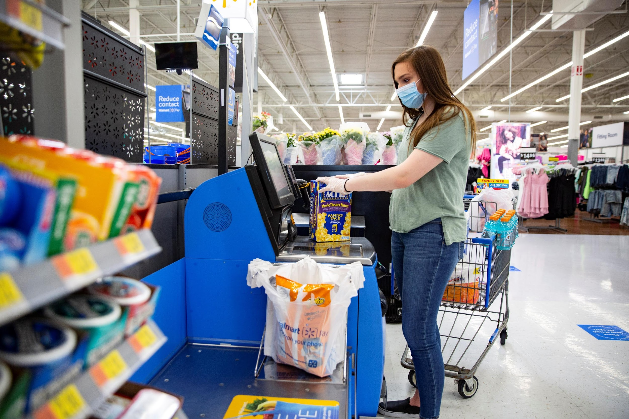
Why This Analysis
Strategic Decision-Making: Analyzing Q1 2019 data from three Walmart stores enables strategic decisions by identifying top-performing stores.
Customer Demographic Understanding: Demographic patterns of profitable stores offer deep insights for targeted strategies.
Profitability Enhancement: Focused on identifying enhancements, the analysis highlights areas for improvement in store operations, customer service, and product assortment. Strategic adjustments aim tomaximize profitability across all Myanmar stores.
Notes:
Customer demographic understanding: understanding age groups, genders, and key factors informs precise marketing, product selection and customer engagement.

Slide 6
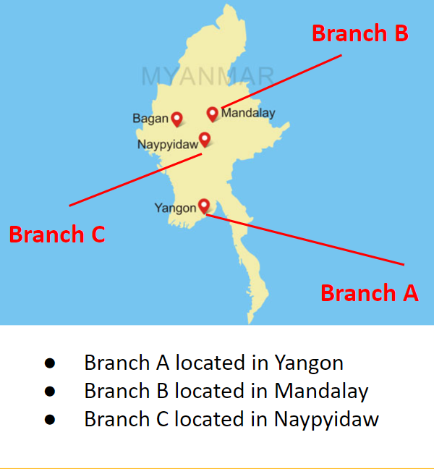
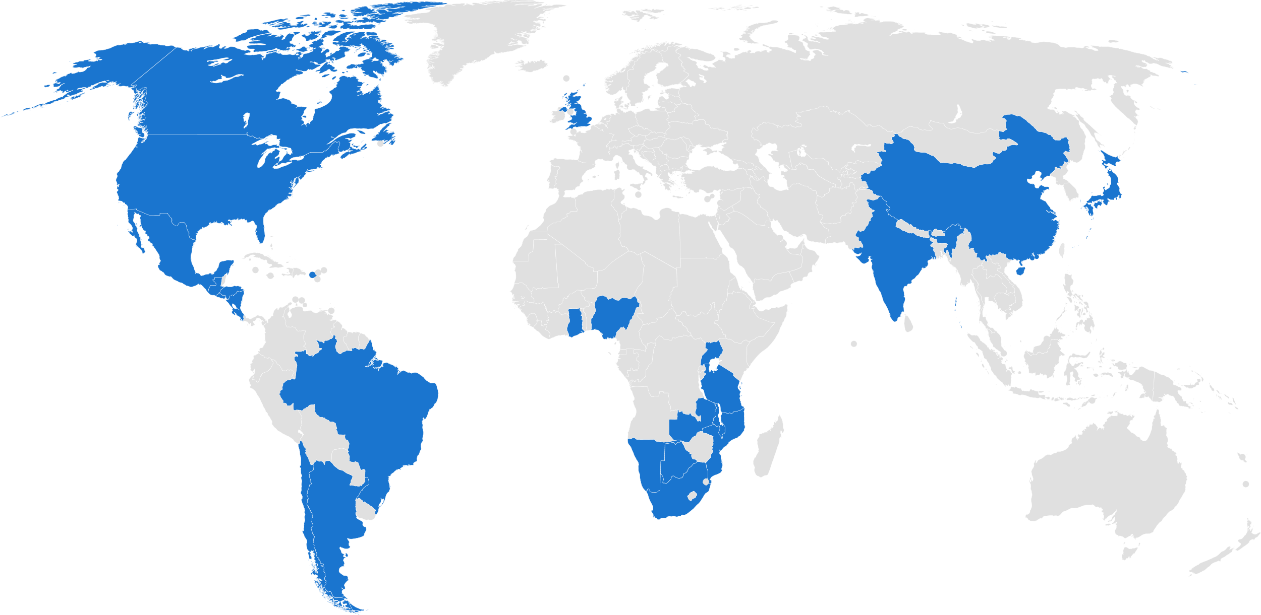
Walmart in Myanmar

Slide 7
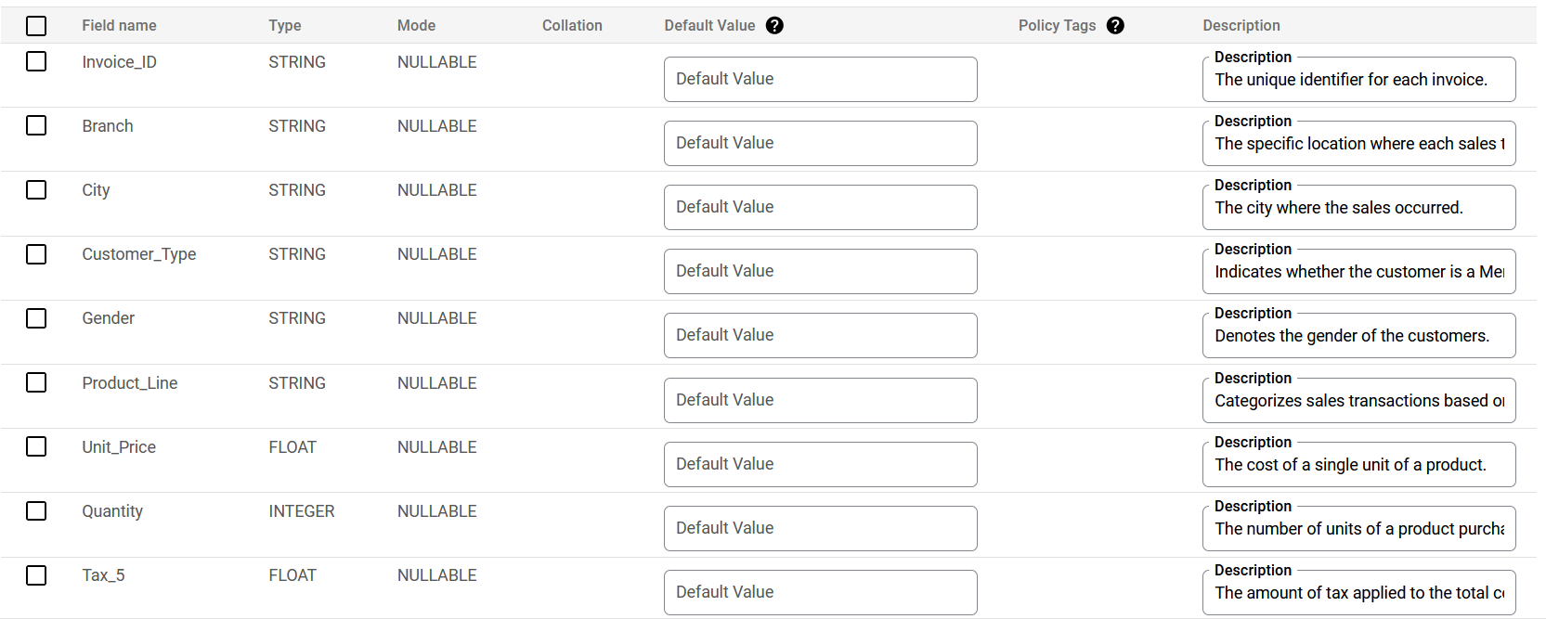
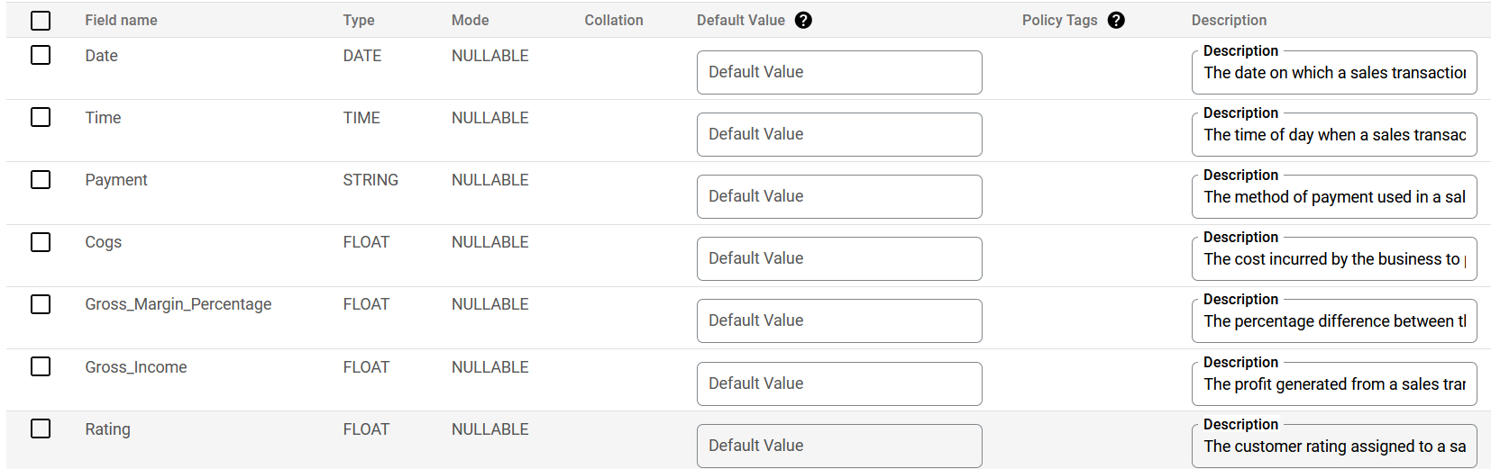
Schema

Slide 8
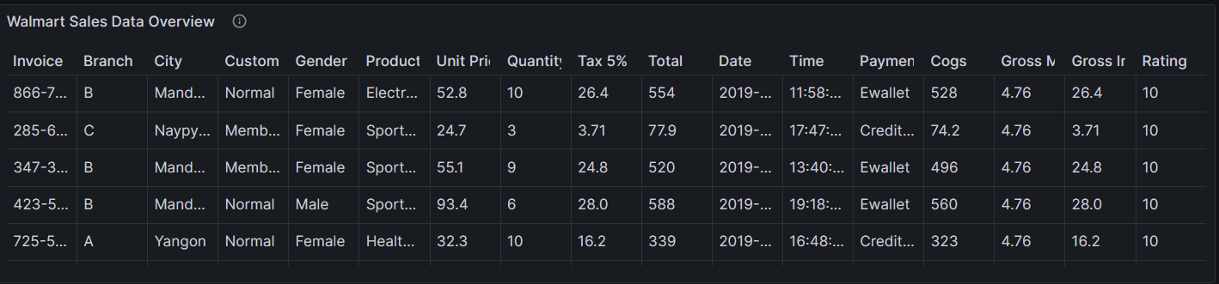
Overview of Dataset: Walmart Sales

Slide 9
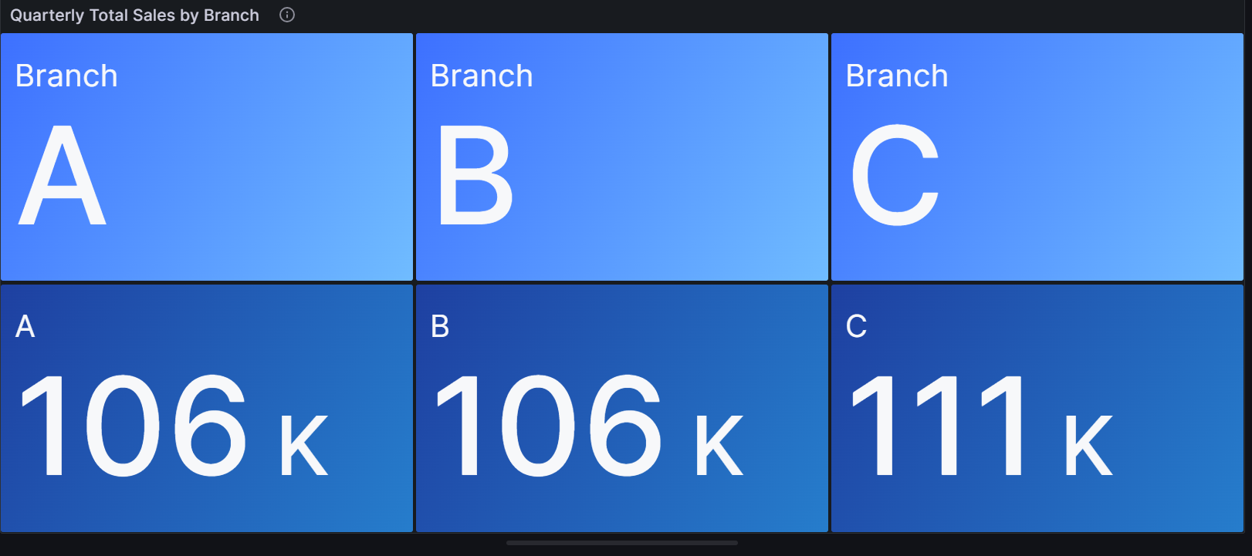
Quarterly Total Sales by Branch
This shows first three months Q1 (2019/1-2019/3) of total amounts sold in each branch.

Slide 10
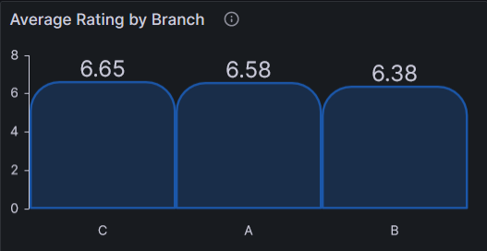
Average Rating by Branch
This bar chart represents average rating of the products by female customer in branch C.

Slide 11
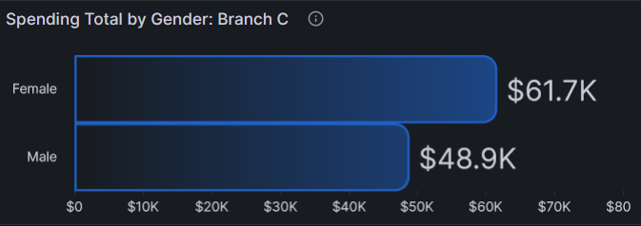
Spending Total by Gender: Branch C
This is the sum of total amounts spend by different gender in Branch C

Slide 12
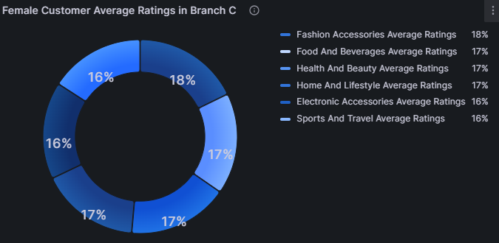
Female Customer Average Ratings in Branch C
The pie chart shows the average ratings on each products received from female customers in Branch C.

Slide 13
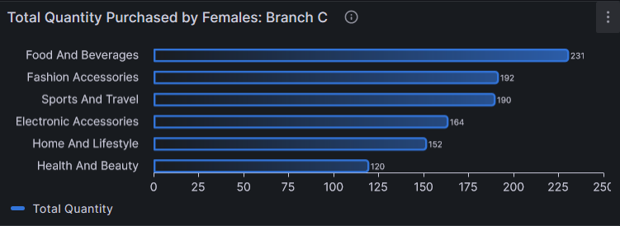
Total Quantity Purchased by Females: Branch C
This panel describes the total quantity of items purchased for each product by female customer in group C and grouped product line.

Slide 14
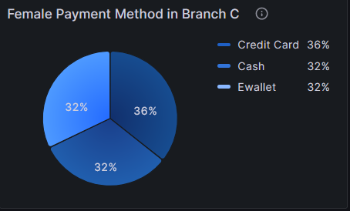
Female Payment Method in Branch C
The pie chart shows the percentage of female customers who used each payment method in Branch C.

Slide 15
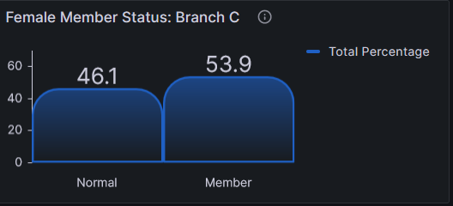
Female Member Status: Branch C
This bar chart reflects the percentage of female customers who is normal and member in Branch C.

Slide 16
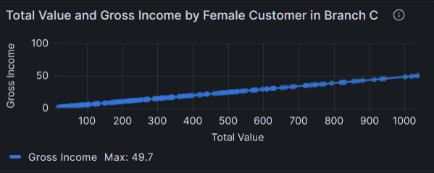
Total Value of Gross Income by Female Customers in Branch C
This panel describes total value and gross income contributed by the female customers in Branch C.

Slide 17
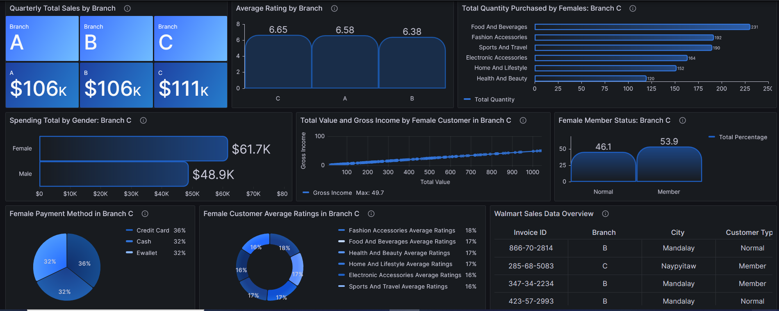
DashBoard Overview
Overview of various aspects related to sales performance, customer demographics, and product preferences in Branch C.

Slide 18
Conclusion
Branch C have highest amount of sales and profit.
Branch C is located in the country’s capital which might be a reason behind this.
The majority of customers in Branch C are females.
Their biggest spending is on food and beverages, we can conclude that people are still using walmart as daily grocery shopping.
Second largest revenue from product category line is fashion accessories.
Walmart
Notes:
By doing this research, we can see that the Brach C have the most selling figures, and we can assume that because Branch C is located in the country’s capital, and the majority of customers in Branch C are female, with their biggest spending is on food and beverages, by analyzing the data, we can refer that people are still using walmart as daily grocery shopping.
However, the second largest revenue from product category line is fashion accessories, which means we will may have a great potential growth on that field.
We can also tell that even though we have a lot of female customer in Branch C, but most of them are not our member yet, which means people are just coming and doing the purchase but without loyalty.
We may creating some offer to attract more customers for joining the membership.

Slide 19




Walmart
Future Research
Analyze customer buying patterns to increase sales in the other two branches.
Have promotions or discounts influenced the choice of payment methods among female customers in Branch C?
Increase incentives for male customers to come to the store and make purchases.

Slide 20
Thank You
By Group 8

